Slide 1
Transportation Planning 599
Cool
tools
for
successful transportation
projects
Troy Hearn
Division of Planning

Slide 2
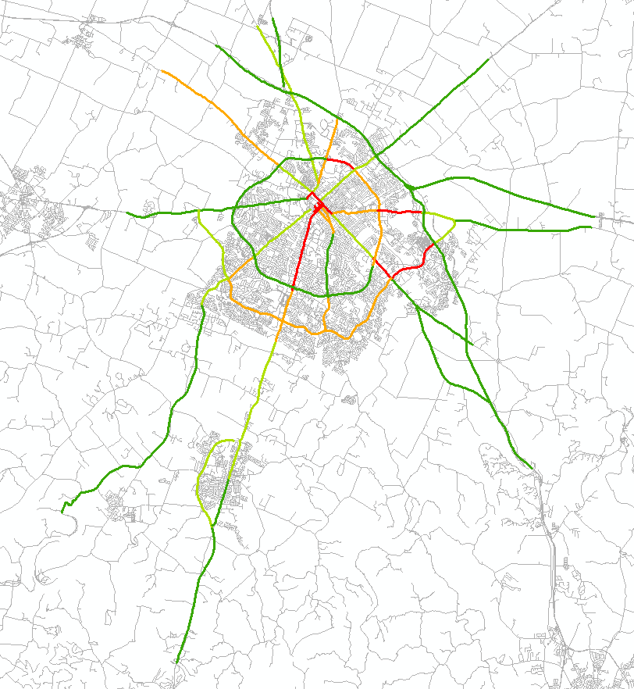
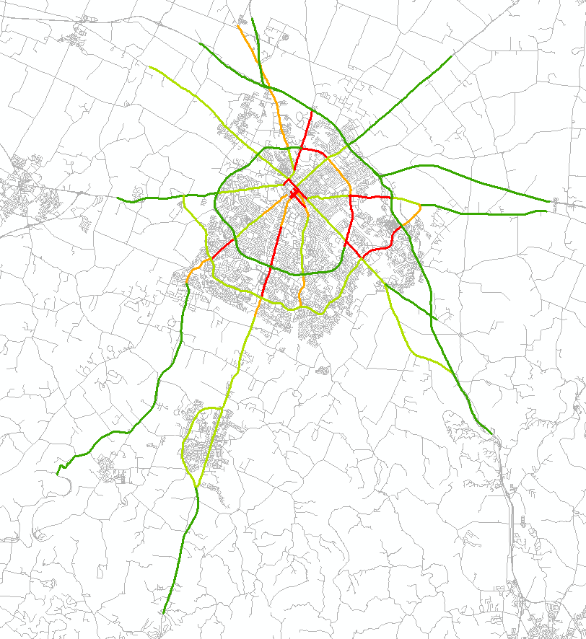
Travel Time- Statewide Data
2011 PM Cardinal Direction
2012 PM Cardinal Direction
The indicate how much longer it takes compared to Speed Limit = Travel time factor
Notes:
This is an example of Lexington Corridors
Since 2011, KYTC has purchased speed data for nearly all roads in Kentucky. These are examples of mapping the available data that is available using GIS portal maintained by the University of Kentucky. In these examples, Speed Limit was used as the “Normal” or Reference Speed. Nicholasville Road (use a laser pointer if you have one) appears RED in these peak PM charts. These are known as Travel Time Indices; they describe the longer travel time during peak hours. The RED segments take more than 60% longer during the afternoon peak traffic than during off peak times or when you are able to go the speed limit. Man-O-War appears ORANGE in 2011 and improves to LIGHT GREEN in 2012. We need to be careful; while it seems Man O War has improved, it could be due to a change in posted speed. Tates Creek Road which is GREEN in 2011 degrades to LIGHT GREEN in 2012, suggesting a reduction of travel speed of roughly 5 mph.

Slide 3
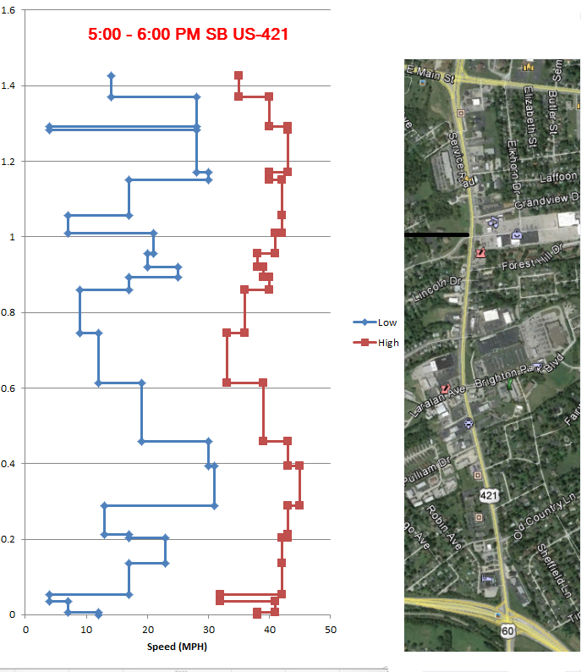
Travel Time - Corridor Profiles
Blue are Minimum Speeds.
Red are Maximum Speeds.
Arrow is the direction of travel at Average Speed.
Notes:
Zooming from regional area, to a single corridor. Here is a 1.6-mile corridor, US-60 in Frankfort between the East-West Bypass and US-460-Georgetown Road. This example was developed for a FHWA Pedestrian Safety Study.
The areas that had wide ranges in speed are less safe for pedestrians. Here the individual segments of the data can be seen as breaks create the horizontal bars in the graphs.
In the morning (left graph) you can see the effect of the signals in the middle and how approach speeds degrade as you proceed into town.
Looking at the chart a different way, the wider the gap between Max and Min suggests choke points.
The range of customization is only limited by your imagination!

Slide 4
Travel Time – Spot Speed Profiles
……by Day, Month, Year, and/or Direction
Notes:
Speed or travel time data is available as a typical day month, year, or even direction, we can customize a data extract for your needs.
This is a histogram speed profile which happens to be a single segment of a bridge west of Prestonsburg in Floyd County. Eastbound (is the blue line) goes in the upward in the inset map and it generally showed lower speeds than Westbound (the red line). The most frequent speed recorded the most often is 31-32 MPH. Note that speed is grouped into 2 MPH bins. One record recorded maximum speed of 66 MPH! ADT on this segment is about 5,300. Keep in mind, if a location has less than 3,000 ADT, we are limited in the data available.

Slide 5
If you are ArcGIS savvy: try this filterable link http://arcg.is/1JmIsCo or to view Link level TT data http://arcg.is/1JmIiuL Click this box > to choose the day part
Statewide Data
If you need customized results contact Daniel.Hulker@ky.gov
Notes:
We hope this spurs interest in our “BIG” data and while the individual record data is not sharable, generalized data is. If you like the area view, that processed data is just clicks way. For those who do not have a GIS Program, you may use the bottom link shown. This will take you to a map of the entire state and you can pan and zoom to your area of interest. The first view stacks three time periods (morning, noon and afternoon peak traffic), so use the Show Contents button to choose one time period at a time. Now if you are familiar with ArcGIS filtering, you can use the top link. UK is providing access to this data. The filterable link defaults to Performance Measure directional data. Be patient, the views are a bit slow to load.

Slide 6
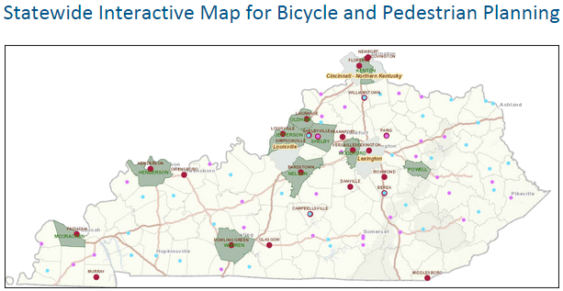
Pedestrian & Bicycle Planning
Local Government adopted projects/plans
http://transportation.ky.gov/bike-walk/Pages/Local-Info.aspx
Notes:
This map provides information on all known bike/ped plans (the projects and the contact agency for these plans) and the GIS data associated with the collection of bike/ped facilities (work program with the ADD Offices).

Slide 7
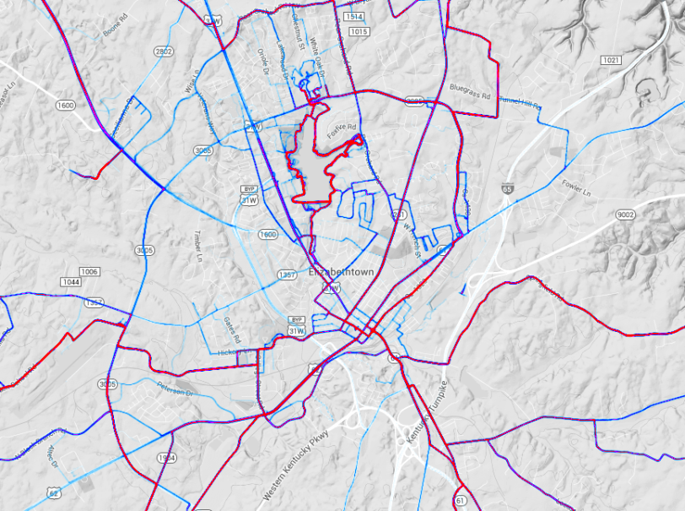
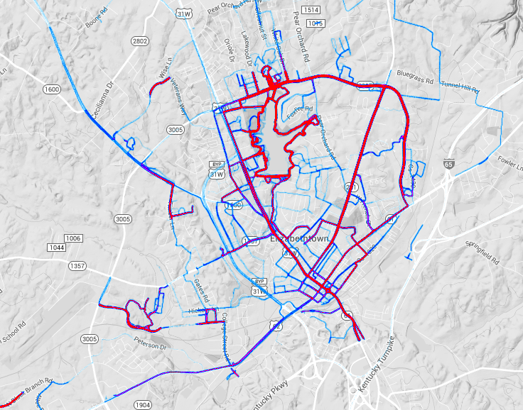
Pedestrian & Bicycle Planning
Strava Heat Map
Bicycle Travel Pedestrian Travel
http://transportation.ky.gov/Bike-Walk/Pages/ResourceLinks.aspx
Notes:
Bicycle Travel: http://labs.strava.com/heatmap/#13/-85.87138/37.70498/gray/bike
Pedestrian Travel: http://labs.strava.com/heatmap/#13/-85.87138/37.70498/gray/run
Strava provides a free data resource of known activity. Strava also provides more specific data (for a fee) of bike/ped ADT, direction of travel, speed, and much more.
The Bike/Ped team has also collect data from the largest bike clubs in the state as to the most popular routes used for mainly recreational riding and the number of riders using these routes.

Slide 8
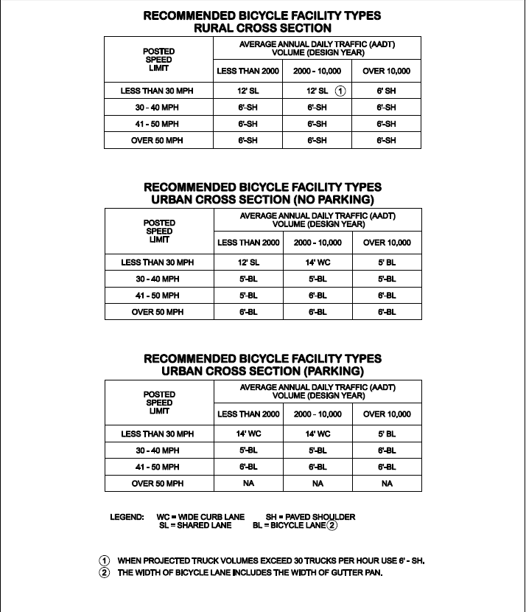
Pedestrian & Bicycle Planning
KYTC Highway Design Manual
(HD-1503 /exhibit 1500-1)
Notes:
The Bike/Ped team has worked with the Office of Highway Design and other KYTC Divisions to update standard drawing and the bike/ped portion of the design manual to consistently accommodate bicycle and pedestrian travel (and ADA issues). The updates to the design manual should be available this next year.

Slide 9
Pedestrian & Bicycle Planning
Resources
AASHTO Bike/Ped Guidance manuals
Stored in Projectwise
FHWA Bike/Ped Web Resources
Links on KYTC’s BikeWalk.ky.gov
University Course on Bike/Ped Design
Sample Bike/Ped Plans
Funding (TAP, TIGER, and RTP)
Notes:
On the following pages you will find all data that was previously housed separately in the Project Identification Form (PIF) and Unscheduled Project List (UPL) database, now together for more efficient use of state resources. For those of you with edit capabilities, you will have the ability to modify your Project information. For everyone else, you will have read only access to select information. Should you need access to all information, please contact the Division of Planning, Strategic Planning Branch. Things of note to consider:
Projects marked 'ACTIVE' are complete and actively pursuing funding.
HIS data can be considered 'LIVE' and accurate for Project Identification purposes.
All dollar amounts are whole dollars and not thousands as they were in the past.
Maps and photos are attached in pdf format where available.
When looking at cost estimates with multiple Revision Numbers, always be certain you are looking at the highest Revision Number for most up to date information.
Each PIF's PDF attachment is for historical purposes only.
Additionally, you will find various documents such as a Data Dictionary and User Guide attached for your understanding and correct use of the PIF Web Application.

Slide 10
Pedestrian & Bicycle Data Resources
Bicycle & Pedestrian Program Coordinator
KYTC
Troy Hearn
Troy.Hearn@ky.gov

Slide 11
Air Quality – VIN Data VIN – Vehicle Identification Number
Model year
# Veh in Co
Vehicle type
Vehicle make
Vehicle class
Mobile/MOVES
Registration type
Fuel type
County registered
Street address
City
State
Zip code
Notes:
Since 1981, every model year has a unique 17-digit referred to as the VIN.
Digits 1 through 3 make up the World Manufacturer Identifier.
Nation of origin, manufacturer, and vehicle type
Digits 4 through 9 make up the Vehicle Descriptor Section.
Model, Body type, restraint system, transmission type, engine code, and valid VIN.
Digits 10 through 17 make up the Vehicle Identifier Section.
Model year, manufacturing plant, and production sequence.
Cannot share:
Any and all personal data that might be tied to the user.

Slide 12
Air Quality –EPA MOVES Model
MOVES –MOtor Vehicle Emission Simulator.
Output = total emissions by area by pollutant, by hour, day, month, season, yr
Used for
Regional/MPO Conformity documents
Project-level Analyses
Motor Vehicle Emission Budgets (MVEBs)
CMAQ applications
Notes:
Multiply by traffic count or VMT to get total tons of pollution.
The final output from the MOVES Model can be used for several purposes:
Transportation Conformity documents
Regional-level/Project-level Analyses
Motor Vehicle Emission Budgets (MVEBs)
Congestion Management and Air Quality (CMAQ) applications

Slide 13
Notes:
Nonattainment for 0.070ppm – Campbell, Oldham, Jefferson, Daviess, Henderson, Livingston, and McCracken
Additional Nonattainment for 0.070ppm – Boone, Kenton, Bullitt, Hancock, Graves, and Ballard
Data is based off of analysis years 2012-2014. When you start looking at 2013-preliminary 2015 data, areas around the state improve (esp. WKY).

Slide 14
Freight Planning
Freight Modes Book
Freight Network
Major Freight Generators
Business Info
Freight Analysis Framework
Multi-State Research Groups
Assistance to Locate Information
Notes:
We use multiple tools to develop an image of the movement of freight around Kentucky. To understand the freight system, you need information about what is being produced in the state and how it gets to its consumers. You need to know how the supply chain within the state operates and where to find additional information when it is not readily available.

Slide 15
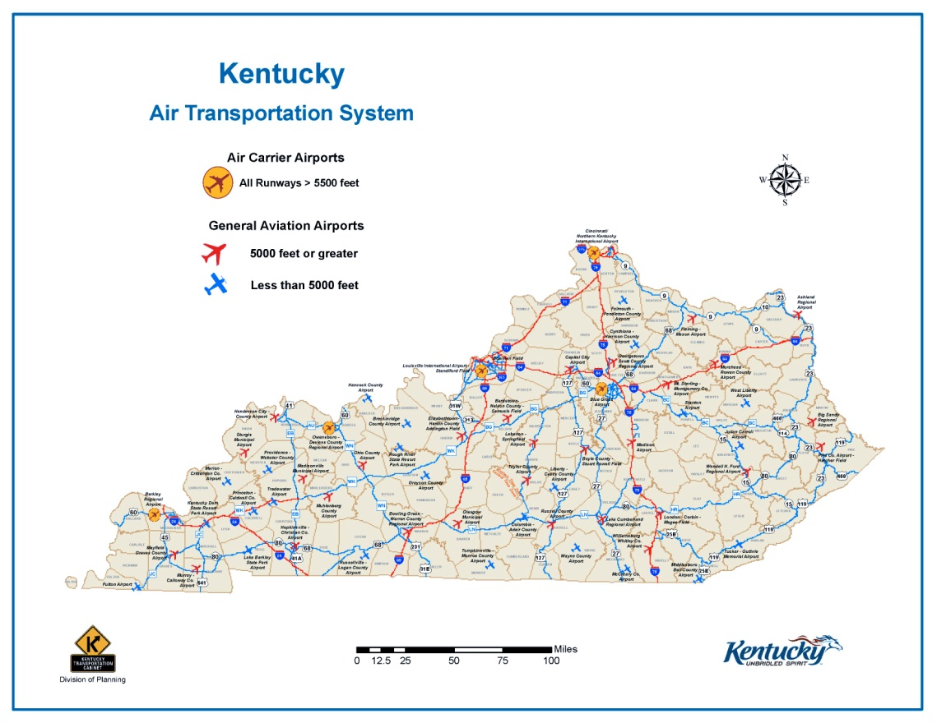
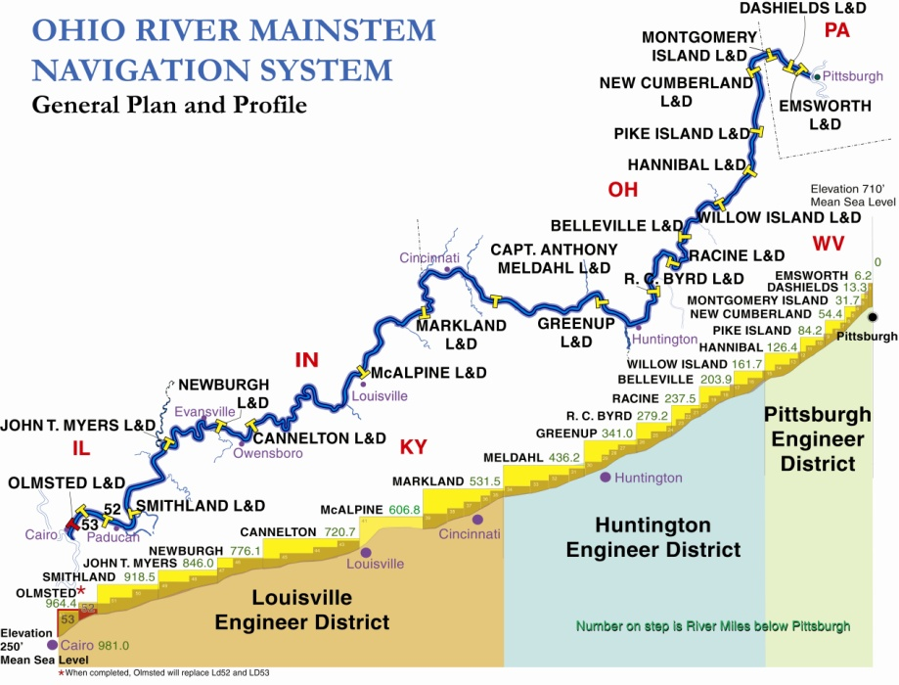
Freight Planning
Freight Modes Book
http://transportation.ky.gov/Planning/Documents/2015%20Modes%20Book.pdf
Notes:
The Freight Modes Book provides users with location and contact information for highway, rail, waterway, and pipeline facilities around the state. The information is updated every 2 years.
This is a great tool for identifying stakeholders that might be interested in a particular highway project in their area.

Slide 16
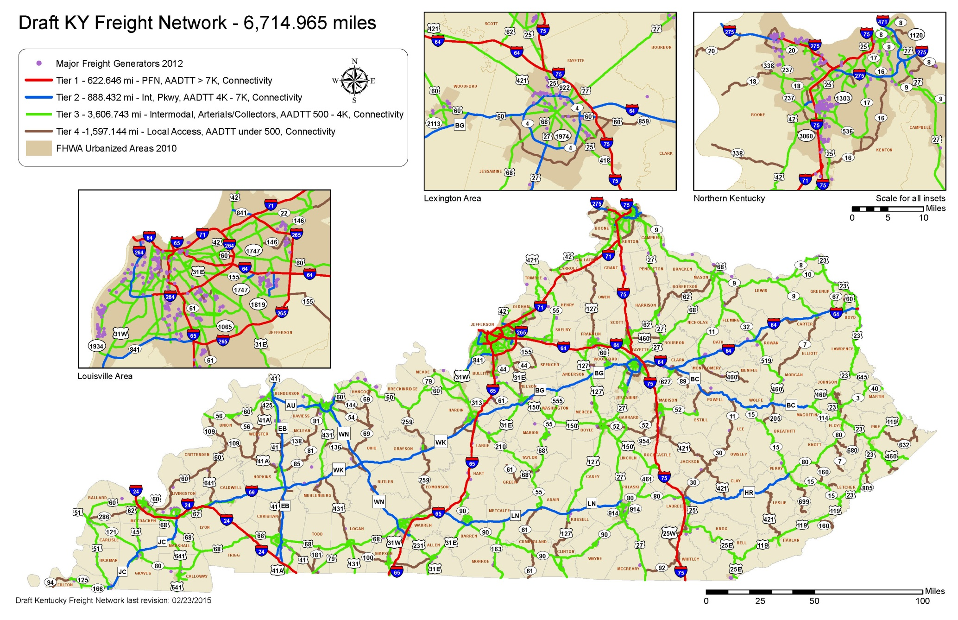
Freight Planning
Freight Network
Notes:
Freight Network developed for use in the 6 year planning process. Potential projects that are located on the Freight Network will get “extra credit”. At this time, there is no additional federal funding available for freight-related projects but it is anticipated that the next transportation funding legislation will provide additional opportunities for routes located on an identified statewide network of highways important for freight transportation.
Network was developed with 4 tiers; with consideration given to NHS, truck percentages, and connectivity to major freight generators.

Slide 17
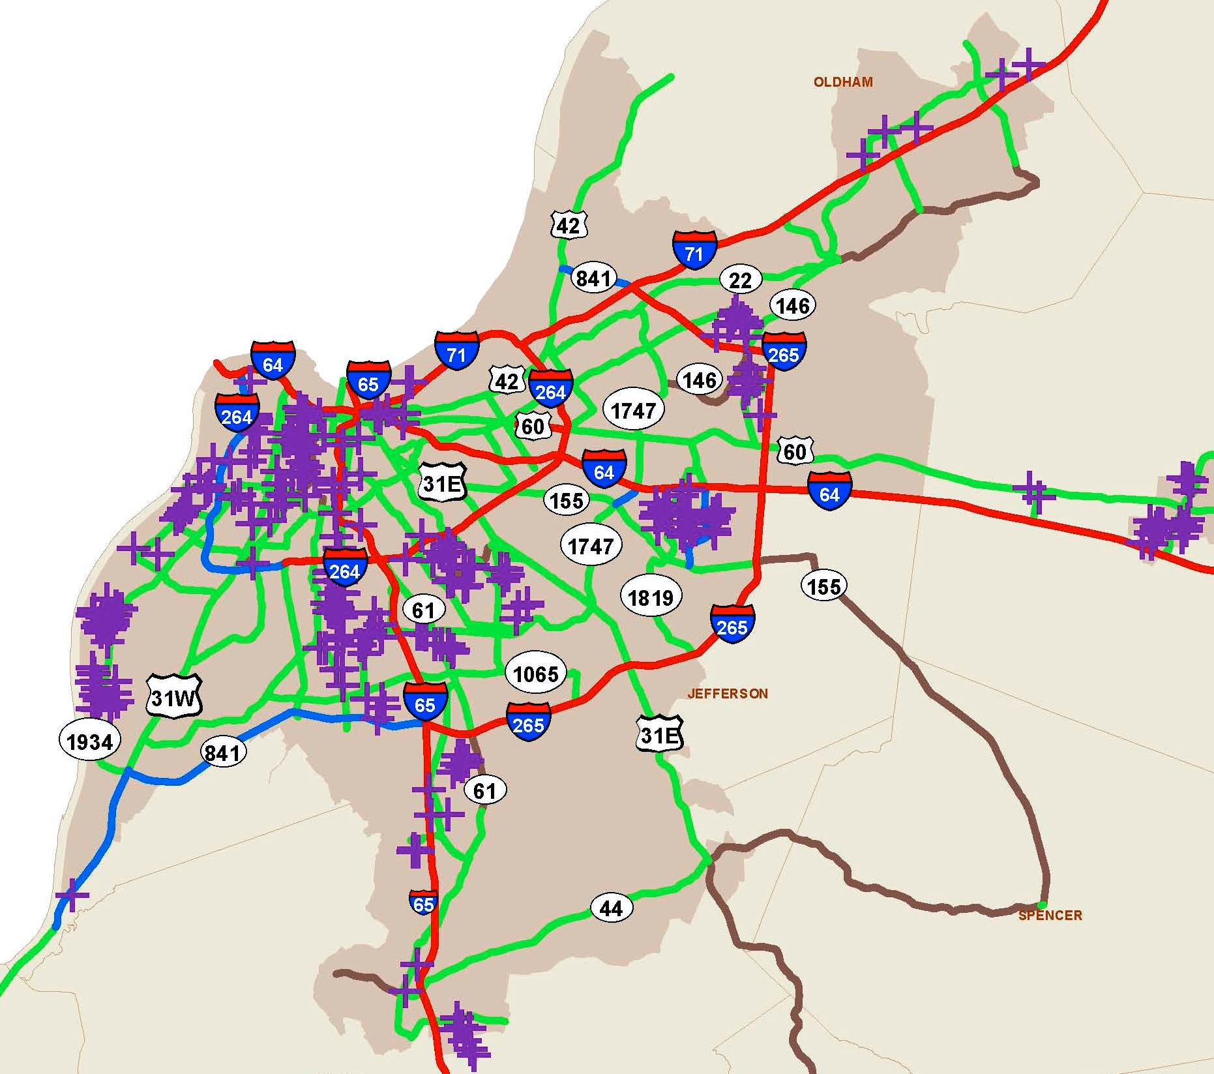
Freight Planning
Major Freight Generators
Company Name
Contact Info
Number of Employees
Building Square Feet
# of Truck Bays
Average # of Trucks per day
# of Rail Doors
NAICS Codes (Commodities)
Needs Assessment
Notes:
Businesses with major impact on transportation of freight have been identified through their number of employees and/or volume of shipping. Their locations and routes to the NHS may help explain differences in ADT or AADTT They may also impact, for example, the design of roads in the vicinity in terms of pavement, roadway width or turning radii.

Slide 18
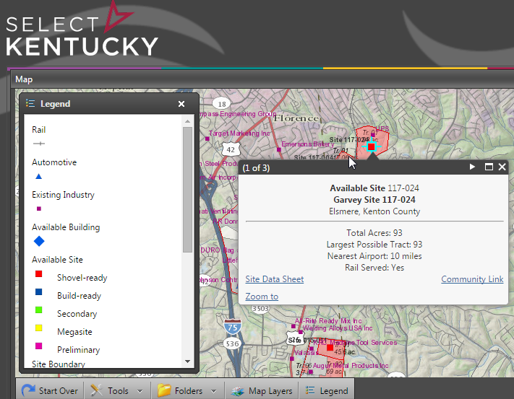
Freight Planning
Business Information
Cabinet for Economic Development – interactive mapping
Kentucky Library and Archives – InfoUSA database
Notes:
The Cabinet for Economic Development has provided Transportation with a shapefile that was used to develop the Major Freight Generators data. It includes the name and address of each business, the number of employees, and codes that describe the type of business or product they provide. The information, particularly the number of employees and business codes, is updated on an annual basis by CED, especially for any businesses that are receiving tax or other incentives from that Cabinet.
The interactive map is updated as sites are used or become available. Note that the site information includes links to the community as well as more in-depth description of the available site. You can also click on a business to see its name, address, opening year and business code.

Slide 19
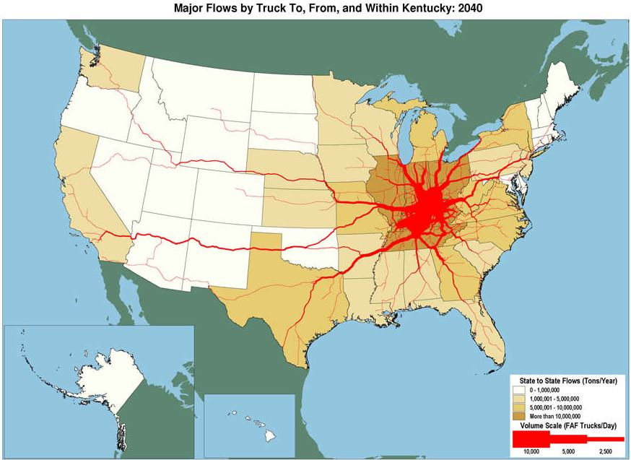
Freight Planning
Freight Analysis Framework (FAF) – Data Tab Tool
Domestic Trade
Exports from KY
Top 5 Trade Partners
by Value ($M)
KY $162,444
Domestic Trade
Exports from KY
Top 10 Commodities
by Value ($M)
http://faf.ornl.gov/fafweb/Extraction0.aspx
Notes:
Use FHWA’s Freight Analysis Framework (FAF) to look at domestic and international trade by commodity, value, tonnage, distance, and mode of transport.
Look at Kentucky’s top trade partners in the US as well as international.
Choose from over 40 different commodity types.
Review past trade and future trade from 1997 to 2040.

Slide 20
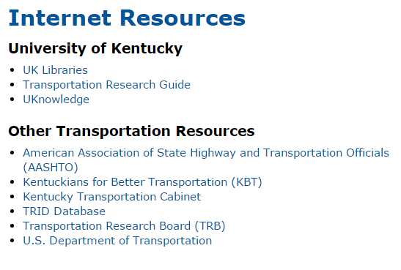
Ask a Librarian
Freight Planning
Assistance To Locate Information
Kentucky Transportation Center –
Call 800-432-0719
Kentucky Library and Archives
www.kdla.ky.gov/Pages/AskALibrarian.aspx
Notes:
Need to locate a specific title? Need information on a subject? Need a literature search? Let the library staff search their resources to locate the items or information you need. Email them at KTC Technology Transfer Program Library or call 800-432-0719, 859-257-2155 or 859-257-8267. The library is located in room 128 of the Raymond Building and is open from 8:00 am - 5:00 pm, Monday - Friday. The library is closed on University holidays.
You can borrow general books and reports for four weeks, with renewal possible, in most instances, if no one else is waiting for the material.
You can borrow videos for two weeks at a time.
It's easy to use the Library! You can request materials by phone, fax, email or in person. Visitors are always welcome.
KDLA
Information for Kentucky Government Employees
This service is designed to assist state employees with questions related to their work, including in-depth research, reference look-up, requesting videos and DVDs, and obtaining materials from other libraries through interlibrary loan (ILL).
Information Request Form
To request books and audiobooks from the KDLA collection use the "Request This Item" link in the KDLA Catalog.

Slide 21
Consultant List
Interactive Maps
Roadway Viewer: http://maps.kytc.ky.gov/photolog/?config=Photolog&x1=5114935.959483551&y1=3868453.589951066&x2=5427435.959483551&y2=3971969.214951066&MODE=PL
Project Archives: http://maps.kytc.ky.gov/photolog/?config=ProjectArchives
Dataminer for bridges: http://maps.kytc.ky.gov/photolog/?config=BridgeDataMiner
KYTC Highway Design
KYTC Design Manual: http://transportation.ky.gov/Highway-Design/Pages/Highway-Design-Manual.aspx
KYTC Planning
Planning Studies and Reports: http://transportation.ky.gov/Planning/Pages/Planning-Studies-and-Reports.aspx
Traffic Forecasting: http://transportation.ky.gov/Planning/Pages/Traffic-Forecasting.aspx
Notes:
The Bike/Ped Team also uses many of the interactive maps on the KYTC web site. Photo van View (Roadway Viewer), traffic counts, the active projects map, and many more.

Slide 22
Consultant List
Data Mart
HIS Extract: http://datamart.business.transportation.ky.gov/EDSB_SOLUTIONS/HISEXTRACTS/
New Traffic Counts page: http://datamart.business.transportation.ky.gov/EDSB_SOLUTIONS/CTS/
Other
Signal Warrants: http://mutcd.fhwa.dot.gov/HTM/2003r1/part4/part4c.htm
Concepts for Congestion: http://transportation.ky.gov/Congestion-Toolbox/Pages/Traffic-Signals.aspx
Notes:
A data mart is the access layer of the data warehouse environment that is used to get data out to the users. The data mart is a subset of the data warehouse that is usually oriented to a specific business line or team. Data marts are small slices of the data warehouse.
Like a shopping mart, except you are replacing the food with data.

Slide 23
AQ Resources
KYTC AQ Website:
http://transportation.ky.gov/Planning/Pages/Air-Quality.aspx
FHWA AQ Website:
http://www.fhwa.dot.gov/environment/air_quality/
EPA AQ/Model Website:
http://www2.epa.gov/learn-issues/learn-about-air
http://www.epa.gov/otaq/models/moves/
My Contact Info:
Justin.harrod@ky.gov or (502) 782-5059
Notes:
**** Justin… put these web links on the appropriate slide… about 22 pt font near bottom.

Slide 24
Thank you!
Enjoy the 2015 Partnering Conference

